Slide 1
Welcome to International Conference on Inventive Computation Technologies(ICICT 2026) CrossTongueGuard: Detecting Cyberbullying in Code-Mixed Conversations
Paper ID: ICICT-1343

Slide 2

CrossTongueGuard: Detecting Cyberbullying in Code-Mixed Conversations.
Presented By :
B. Denesh Kumar | - | 22891A6606
K. Srinadh | - | 22891A6622
N. Upender Goud | - | 22891A6639
P. Bhaskar | - | 22891A6643
Guided By:
K. Sudhakar
Assistant Professor

Slide 3
1. INTRODUCTION
The rapid growth of social media platforms and online communication has significantly increased the amount of user-generated content on the internet.
While these platforms provide opportunities for interaction and knowledge sharing, they have also led to the emergence of harmful behaviors such as cyberbullying.
Cyberbullying refers to the use of digital communication platforms to harass, threaten, or harm individuals through offensive messages, abusive language, or aggressive behavior.
This issue has become a major concern as it can lead to emotional distress, psychological trauma, and social isolation among victims.
In multilingual societies, users often communicate using code-mixed language, where words from multiple languages are combined within a single sentence.
For example, users may mix English with regional languages while expressing their thoughts online. This type of language usage makes it difficult for traditional text classification systems to accurately detect harmful or abusive content.
The presence of slang, informal expressions, and transliterated words further increases the complexity of analyzing such text.

Slide 4
Traditional cyberbullying detection methods mainly rely on keyword filtering or basic machine learning techniques, which often fail to understand the contextual meaning of code-mixed conversations.
As a result, many harmful messages remain undetected or are incorrectly classified. Therefore, there is a need for an intelligent and context-aware system that can effectively detect cyberbullying in multilingual and code-mixed environments.
To address this challenge, this project proposes CrossTongueGuard, an automated cyberbullying detection framework that combines traditional machine learning models with advanced transformer-based language models.
The system performs text preprocessing, feature extraction, and contextual analysis to identify harmful messages in code-mixed conversations.
By using statistical and contextual learning approaches, the proposed system aims to improve the accuracy and reliability of cyberbullying detection and contribute to creating a safer online communication environment.

Slide 5
2. PROBLEM STATEMENT
The rapid growth of social media platforms and online communication has led to a significant increase in cyberbullying incidents.
Users often post abusive, aggressive, or harmful messages that target individuals or groups, which can lead to emotional distress, psychological trauma, and negative social impacts.
Detecting such harmful content manually is extremely difficult due to the massive volume of user-generated text produced every day.
The problem becomes more complex in multilingual environments, where people frequently communicate using code-mixed language, combining words from multiple languages in a single sentence.
In addition, users often use slang, abbreviations, and transliterated words, making it difficult for traditional cyberbullying detection systems to correctly interpret the meaning of the text.
Most existing systems are designed for single-language text and rely on basic keyword filtering or traditional machine learning techniques.

Slide 6
These approaches often fail to capture the context and semantic meaning of code-mixed conversations, resulting in inaccurate predictions and undetected harmful messages.
Therefore, it is important to develop an intelligent and efficient system that can automatically analyze multilingual code-mixed text and accurately detect cyberbullying content.
Problem Addressed
Increasing cyberbullying on online platforms
Difficulty in detecting harmful messages automatically
Code-mixed language complicates text analysis
It’s Importance
Protects users from online harassment
Helps platforms monitor harmful content
Promotes safer digital communication environments

Slide 7
3. OBJECTIVES
Aim of the Project
The main aim of this project is to develop an cyberbullying detection system capable of analyzing multilingual code-mixed conversations and identifying harmful or abusive content using machine learning and transformer-based language models.
The system evaluates different models independently and compares their performance to determine the most effective model for accurate cyberbullying detection.
Specific Objectives
To collect and prepare a dataset containing cyberbullying and non-cyberbullying text messages.
To perform data preprocessing techniques such as text cleaning, tokenization, and stop-word removal to prepare the data for analysis.
To perform exploratory data analysis to understand the distribution and characteristics of the dataset.
To extract textual features using techniques such as TF-IDF and tokenizer-based representations.
To train multiple machine learning models such as Logistic Regression, Naïve Bayes, and Support Vector Machine for cyberbullying classification.

Slide 8
To fine-tune transformer-based models such as XLM-RoBERTa, mDeBERTa and MuRIL to capture contextual meaning in multilingual text.
To evaluate each model using performance metrics such as accuracy, precision, recall, and F1-score.
To compare the performance of all models and identify the best-performing model for cyberbullying detection.
To develop a user interface that allows users to input text and receive prediction results from the trained models.

Slide 9
4. EXISTING SYSTEM
In existing cyberbullying detection systems, harmful or abusive content in online platforms is typically identified using traditional text classification techniques.
Many systems rely on machine learning algorithms such as Logistic Regression, Naïve Bayes, and Support Vector Machines to classify messages as cyberbullying or non-cyberbullying.
These systems usually process text using simple feature extraction methods such as Bag-of-Words or TF-IDF representations.
The models are trained on labeled datasets to identify patterns related to abusive or offensive language in online messages. Such systems are commonly used for monitoring user-generated content on social media platforms.
However, most existing systems face difficulties when dealing with multilingual and code-mixed text commonly used in online conversations.
Users often mix multiple languages within a single sentence and use informal words, abbreviations, and slang, which reduces the effectiveness of traditional classification methods.
As a result, existing systems may fail to capture the contextual meaning of the text and may produce inaccurate predictions in real-world social media environments.

Slide 10
Limitations of Existing System:
Most existing systems are designed for single-language text, making them less effective for multilingual or code-mixed conversations.
Traditional models rely mainly on keyword-based or statistical features, which often fail to capture the true contextual meaning of sentences.
Many systems cannot properly interpret slang, abbreviations, emojis, and informal expressions commonly used in social media communication.
Cyberbullying messages are sometimes context-dependent, and simple models cannot understand sarcasm, irony, or hidden aggression.
Traditional approaches may produce high false positive or false negative predictions, reducing the reliability of the system.
Many existing models are trained on limited or domain-specific datasets, which affects their performance when applied to real-world data.
Some systems lack the ability to analyze semantic relationships between words, which is important for understanding harmful intent.
Traditional models do not effectively capture long-range dependencies and contextual information in text.

Slide 11
5. PROPOSED SYSTEM
To overcome the limitations of existing cyberbullying detection systems, this project proposes CrossTongueGuard, a cyberbullying detection framework designed to analyze multilingual code-mixed conversations.
The system uses both traditional machine learning algorithms and advanced transformer-based language models to classify text messages as cyberbullying or non-cyberbullying.
The proposed system first performs data preprocessing to clean and normalize the text data by removing noise such as punctuation, special characters, and stop words.
After preprocessing, the text is converted into numerical representations using techniques such as TF-IDF feature extraction for machine learning models and tokenization with embeddings for transformer models.
Multiple machine learning algorithms, including Logistic Regression, Naïve Bayes, and Support Vector Machine, are trained independently on the dataset.
In addition, a transformer-based model such as XLM-RoBERTa is fine-tuned to capture contextual and semantic information from multilingual text.
Each model is evaluated separately using performance metrics such as accuracy, precision, recall, and F1-score, and the results are compared to determine the best-performing model.

Slide 12
Advantages over Existing System
Capable of handling multilingual and code-mixed text data.
Uses advanced transformer models that understand contextual meaning better than traditional models.
Provides higher classification accuracy and better prediction performance.
Evaluates multiple algorithms to identify the most effective model for cyberbullying detection.
Improves the ability to detect subtle or context-based abusive language.
Reduces false predictions compared to traditional keyword-based systems.
Can be integrated with online platforms to automatically monitor harmful messages.
Provides comprehensive model evaluation, helping identify the best-performing algorithm.
Can be integrated into social media platforms, chat applications, and online forums for automatic monitoring.
Helps create a safer and healthier online communication environment.
The system is scalable and adaptable for analyzing large volumes of text data.

Slide 13
6. SCOPE OF THE PROJECT
The proposed cyberbullying detection system can be applied in various online platforms to automatically monitor and identify harmful messages.
It can be integrated into social media platforms, online forums, and chat applications to detect abusive or offensive content in user-generated messages.
The system can assist platform moderators in filtering harmful content and maintaining a safe communication environment.
The project can also be useful in educational institutions and online learning platforms where students interact through digital communication tools.
By detecting cyberbullying behavior, the system can help prevent harassment and protect users from harmful online interactions.
Additionally, the framework can be adapted for content moderation systems, community management tools, and digital safety monitoring systems.

Slide 14
Boundaries of the Work
The system focuses mainly on text-based cyberbullying detection and doesn’t analyses images, videos, or audio content.
The performance of the model depends upon the quality and size of the training dataset used.
The system may face challenges in detecting sarcasm,irony, or highly context-dependent messages.
The current system is designed as a prototype system and may require further optimization for large scale real-world deployment.
The system analyses individual messages and may not fully consider long conversation history or user behaviour patterns

Slide 15
7. LITERATURE SURVEY
Several research studies have explored the problem of cyberbullying detection in online communication platforms using machine learning and deep learning techniques.
Early research mainly focused on traditional machine learning approaches that classify text messages into bullying and non-bullying categories based on statistical text features.
These approaches used feature extraction techniques such as Bag-of-Words and TF-IDF, along with classification algorithms like Naïve Bayes, Logistic Regression, and Support Vector Machines (SVM).
Although these models provided reasonable performance, they were limited in understanding contextual meaning and often struggled with complex linguistic patterns found in social media text.
With the advancement of deep learning techniques, researchers started using neural network-based models such as Convolutional Neural Networks (CNN) and Long Short-Term Memory (LSTM) networks to improve cyberbullying detection.
These models helped capture sequential patterns and contextual relationships within sentences. However, these approaches still faced challenges in handling multilingual text and informal language commonly used in online conversations.

Slide 16
Recent studies have focused on transformer-based language models such as MuRIL, mDeBERTa and XLM-RoBERTa.
These models use attention mechanisms to capture deeper contextual and semantic relationships between words, making them highly effective for text classification tasks.
Transformer models have shown improved performance in detecting harmful or abusive content, especially in multilingual environments.
However, detecting cyberbullying in code-mixed conversations, where multiple languages are used in the same sentence, remains a challenging problem.
The proposed project builds upon these research efforts by combining traditional machine learning algorithms with transformer-based models to analyze multilingual code-mixed text and evaluate their performance for effective cyberbullying detection.

Slide 17
S.No | Title | Authors | Year | Summary
1 | Explainable Cyberbullying Detection in Hinglish: A Generative Approach | Maity, K., Jain, R., Jha, P.,&Saha,S. | 2025 | Introduces an explain able cyberbullying detection framework for Hinglish text using a multitask generative model that performs sentiment analysis, rationale extraction and target identification.
2 | Multilingual Representations for Indian Languages (MuRIL) | Khanuja, S., Bansal, D., Mehtani, S., Khosla, S., Dey, A., Gopalan, B., &Talukdar,P. | 2021 | Presents a multilingual transformer model designed for Indian languages, trained with translated and transliterated datasets to improve performance in multilingual NLP tasks.
3 | DeBERTa:Decoding Enhanced BERT with Disentangled Attention | He, P., Liu, X.,Gao, J.,& Chen,W. | 2021 | Introduces DeBERTa, an improved transformer architecture that separates content and positional information using disentangled attention to enhance contextual understanding.
4 | Unsupervised Cross-Lingual Representation Learning at Scale | Conneau,A.,Khandelwal,K.,Goyal,N.,Chaudhary,V., Wenzek, G., Guzm´an,F.,&Stoyanov,V | 2020 | Presents XLM-R, a multilingual transformer model trained on large multilingual corpora to support cross-lingual tasks such as classification and translation.

Slide 18
S.NO | Title | Authors | Year | Summary
5 | RoBERT:ARobustly Optimized BERT Pretraining Approach | Liu, Y., Ott, M.,Goyal,N., Du, J., Joshi, M., Chen,D., &Levy,O. | 2019 | Proposes an optimized version of BERT with improved training strategies and larger datasets, achieving better results in multiple NLP bench marks.
6 | BERT: Pre-training of Deep Bidirectional Transformers for Language Understanding | Devlin, J., Chang, M., Lee,K.,&Toutanova,K. | 2019 | Introduces BERT, a bidirectional trans former model that captures contextual word representations and significantly improves NLP tasks such as sentiment analysis and text classification.
7 | Automated Hate Speech Detection and the Problem of Offensive Language | Davidson,T.,Warmsley, D., Macy, M., & Weber,I. | 2017 | Develops a machine learning system to classify tweets into hate speech, offensive language and neutral content using NLP preprocessing and classification algorithms.
8 | Detecting Hate Speech in Social Media | Malmasi,S.,&Zampieri, M. | 2017 | Applies supervised machine learning tech niques with linguistic features such as n-grams to classify social media posts containing hate speech or offensive language.

Slide 19
S.No | Title | Authors | Year | Summary
9 | Deep Learning for Hate Speech Detection in Tweets | Badjatiya,P., Gupta, S., Gupta,M., & Varma,V. | 2017 | Explores deep learning models such as CNN and LSTM for identifying hate speech in tweets and compares their performance with traditional machine learning methods.
10 | Approaches to Automated Detection of Cyberbullying: A Survey | Salawu, S., He, Y., & Lumsden,J. | 2017 | Provides a comprehensive survey of cyber bullying detection approaches including rule based, supervised learning and hybrid methods, highlighting key challenges.
11 | Hateful Symbols or Hateful People? Predictive Features for Hate Speech Detection on Twitter | Talat, Z., & Hovy,D. | 2016 | Investigates linguistic and contextual features that help identify hate speech in Twitter data using annotated datasets and machine learning models.
12 | Bullying in the Digital Age: A Critical Review and Meta-analysis of Cyberbullying Research Among Youth | Kowalski,R., Giumetti, G., Schroeder,A., & Lattanner, M. | 2014 | Conducts a meta analysis of cyberbullying research focusing on psychological effects, causes and behavioral patterns among young social media users.

Slide 20
S.No | Title | Authors | Year | Summary
13 | Code Mixing: A Challenge for Language Identification in the Language of Social Media | Barman,U.,Das,A.,Wag ner, J., & Foster,J. | 2014 | Examines the problem of code-mixed language in social media and proposes machine learning techniques to identify languages at the word level.
14 | Cyberbullying Re defined: An Analysis of Intent and Repetition | Walker,C.M. | 2014 | Analyses cyberbullying behaviours by emphasizing two major characteristics: intentional harm and repeated aggression in online communication.
15 | Detecting Offensive Language in Social Media to Protect Adolescent Online Safety | Chen,Y.,Zhou,Y.,Zhu, S.,&Xu,H. | 2012 | Proposes an early offensive language detection system using NLP preprocessing and machine learning classifiers based on textual features.
16 | Cyberbullying and Self-Esteem | Patchin,J.W.,&Hinduja,S. | 2010 | Examines the psycho logical effects of cyberbullying and shows that victims often experience reduced self esteem, stress and emotional distress.

Slide 21
8. SYSTEM REQUIREMENTS
Software Requirements
Hardware Requirements
Operating System: Windows
Programming Language: Python
Development Environment: VS Code
Libraries:
NumPy
Pandas
Scikit-learn
Matplotlib
Seaborn
Transformers (Hugging Face)
Frameworks: streamlit
Dataset Source: Cyberbullying text datasets
from online repositories like Kaggle.
Processor: Intel Core i5 or higher
RAM: Minimum 8 GB
Storage: Minimum 256 GB Hard Disk / SSD
GPU: Optional (for faster transformer model training)
System Type: 64-bit architecture

Slide 22
9. SYSTEM ARCHITECTURE
The proposed cyberbullying detection system follows a structured workflow that processes text data through several stages in order to accurately classify messages as cyberbullying or non-cyberbullying.
First, the system collects a labeled dataset containing cyberbullying and non-cyberbullying messages. The collected data is then passed to the data preprocessing module, where text cleaning operations such as removing punctuation, converting text to lowercase, tokenization, and stop-word removal are performed.
After preprocessing, the cleaned text is transformed into numerical representations through feature extraction techniques.
For traditional machine learning models, TF-IDF feature extraction is used to convert text into feature vectors. For transformer-based models, tokenization and contextual embeddings are generated using the transformer tokenizer.
The processed data is then used to train multiple machine learning models such as Logistic Regression, Naïve Bayes, and Support Vector Machine, as well as a transformer-based model (XLM-RoBERTa). Each model is trained independently and evaluated using performance metrics such as accuracy, precision, recall, and F1-score.
Finally, the trained models are used in the prediction module, where user input text is analyzed and classified as cyberbullying or non-cyberbullying. The prediction result is then displayed through the user interface.

Slide 23
Architecture
Input
Code-Mixed Social Media text
Text Preprocessing Module
Cleaning
Normalization
Noise Removal
Evaluation Metrics
Accuracy
Precision
Recall
F1-Score
Semantic Context Based Labelling
Context Understanding
Semi-Automatic Semantic Labelling
Binary Labels(0/1)
Multi-Aspect Labelling
Intent
Harm
Aggression
Enter any Text
Exploratory Data Analysis
Correlation Matrix
Heatmaps
PDF Plots
Box Plot
Model Training
Output Prediction
Cyberbullying/Not Cyberbullying
Logistic Regression
Support Vector Machine
Navie Bayes
MuRIL
mDeBERTa
XLM-RoBERTa
Dataset Preparation Module
Label Encoding
Dataset Balancing(Undersampling)
Feature Representation
TF-IDF
Contextual Embeddings

Slide 24
10. MODULES DESCRIPTION
Data Collection Module
This module is responsible for gathering the dataset required for cyberbullying detection. The dataset contains labeled text messages categorized as cyberbullying or non-cyberbullying. The collected data forms the foundation for training and evaluating the machine learning and transformer models.
Data Preprocessing Module
In this module, the raw text data is cleaned and prepared for analysis. Preprocessing techniques such as converting text to lowercase, removing punctuation and special characters, removing stop words, and tokenization are performed. This step ensures that the text data is standardized and suitable for feature extraction and model training.
Feature Extraction Module
The feature extraction module converts textual data into numerical representations that machine learning models can understand. Techniques such as TF-IDF (Term Frequency–Inverse Document Frequency) are used to transform the processed text into feature vectors. For transformer models, tokenization and contextual embeddings are generated.

Slide 25
Model Training Module
This module trains multiple classification models using the prepared dataset. Traditional machine learning algorithms such as Logistic Regression, Naïve Bayes, and Support Vector Machine (SVM) are trained independently. In addition, a transformer-based models such as MuRIL, mDeBERTa, and XLM-RoBERTa) is fine-tuned to capture contextual relationships in the text.
Model Evaluation Module
In this module, the trained models are evaluated using performance metrics such as accuracy, precision, recall, and F1-score. Visualization techniques such as ROC curves and confusion matrices are used to analyze the performance of each model and compare their effectiveness.
Prediction Module
The prediction module uses the trained models to classify new user input messages. When a user enters a message, the system processes the text using the same preprocessing and feature extraction steps, and the model predicts whether the message contains cyberbullying content or not.

Slide 26
11. METHODOLOGY
The proposed CrossTongueGuard system follows a systematic step-by-step approach to process text data and classify it as cyberbullying or non-cyberbullying.
Initially, a labeled dataset containing cyberbullying and non-cyberbullying messages is collected from reliable sources.
The text has extracted from the collected csv file and new csv file has been created.
The dataset is then passed to the preprocessing stage, where the text is cleaned by converting it to lowercase, removing punctuation, eliminating stop words, and performing tokenization.
After preprocessing, we used semantic AI assisted labelling in order to label the text whether it has intent, harm and aggression.
And based on the labelling it is considered whether the text is cyberbullying or not.
Now the labelled dataset is transformed into numerical representations using feature extraction techniques.
For traditional machine learning models, TF-IDF is used to convert text into feature vectors. For transformer models, tokenization and contextual embeddings are generated using the transformer tokenizer.

Slide 27
The processed data is then used to train multiple models independently. Machine learning algorithms such as Logistic Regression, Naïve Bayes, and Support Vector Machine are trained using the TF-IDF features.
In parallel, a transformer-based model such as MuRIL, mDeBERTa and XLM-RoBERTa are fine-tuned using tokenized text data to capture contextual meaning.
Once training is completed, all models are evaluated using performance metrics such as accuracy, precision, recall, and F1-score.
The results of each model are compared to identify the best-performing model for cyberbullying detection. Finally, in the prediction phase, user input text is processed and classified using the trained models, and the result is displayed through the user interface.
Workflow:
Dataset collection
Text preprocessing
Multi aspect annotation
Feature extraction (TF-IDF / Tokenization)
Model training (ML models + Transformer model)
Model evaluation (Accuracy, Precision, Recall, F1-score)
Model comparison
Prediction of user input
Display result in user interface

Slide 28
12. TOOLS AND TECHNOLOGIES USED
Programming Language
Python : Used for implementing data preprocessing, model training, and prediction.
Development Tools
VS Code – for coding and project integration
Libraries and Frameworks
NumPy – numerical computations
Pandas – data handling and preprocessing
Scikit-learn – machine learning algorithms (LR, NB, SVM)
Matplotlib – data visualization
Seaborn – statistical visualization (graphs like boxplot, heatmap)
NLTK – text preprocessing (stopwords, tokenization)
Transformers (HuggingFace) – for transformer models like XLM-RoBERTa, mDeBERTa and MuRIL.
PyTorch / TensorFlow – for deep learning model training

Slide 29
13. IMPLEMENTATION
The proposed CrossTongueGuard system was implemented using Python and various machine learning and natural language processing libraries.
The development process was carried out in multiple stages, including data preprocessing, feature extraction, model training, evaluation, and deployment through a user interface.
Initially, the dataset containing labeled cyberbullying and non-cyberbullying text messages was loaded and analyzed.
In the preprocessing stage, the text data was cleaned by converting it to lowercase, removing punctuation, special characters, and stop words, and performing tokenization.
This step ensured that the text data was in a structured and consistent format suitable for further processing.
After preprocessing, feature extraction techniques were applied. For machine learning models, TF-IDF vectorization was used to convert text into numerical feature vectors.
For transformer models, tokenization and embeddings were generated using the XLM-RoBERTa, mDeBERTa and MuRIL tokenizer, which captures contextual information from multilingual text.

Slide 30
In the model training phase, multiple machine learning algorithms such as Logistic Regression, Naïve Bayes, and Support Vector Machine (SVM) were trained using the extracted features.
In addition, the XLM-RoBERTa, mDeBERTa and MuRIL transformer model was fine-tuned on the dataset to improve contextual understanding and classification performance. Each model was trained independently.
The trained models were then evaluated using performance metrics such as accuracy, precision, recall, and F1-score.
Visualization techniques such as confusion matrices and ROC curves were used to analyze and compare the performance of each model. Based on this comparison, the best-performing model was identified.
Finally, a simple user interface was developed where users can input text messages. The system processes the input using the same preprocessing and feature extraction steps, and the trained model predicts whether the message is cyberbullying or non-cyberbullying.
The result is then displayed to the user in real time.
Important Functionalities
Data Preprocessing
TF-IDF Feature Extraction
Tokenization and Embeddings
Training of ML and Transformer models
Model Evaluation
Input Prediction System

Slide 31
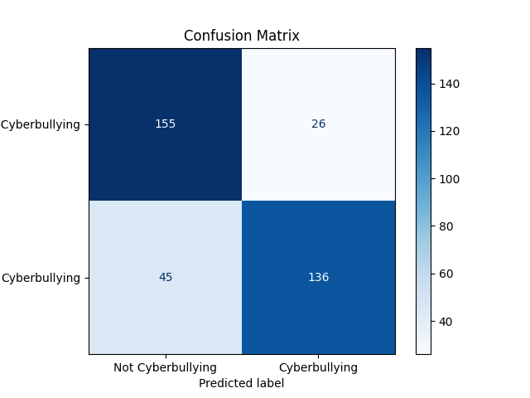
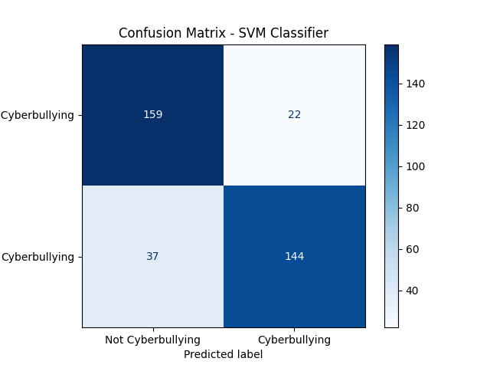
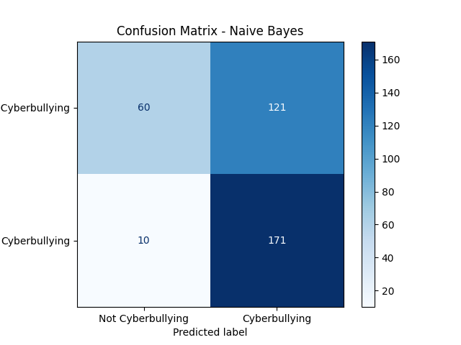
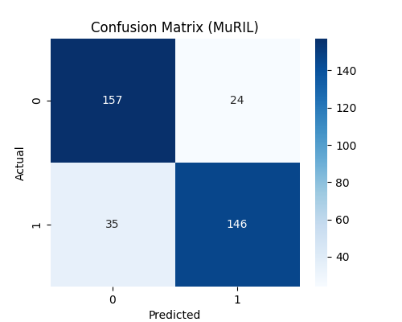
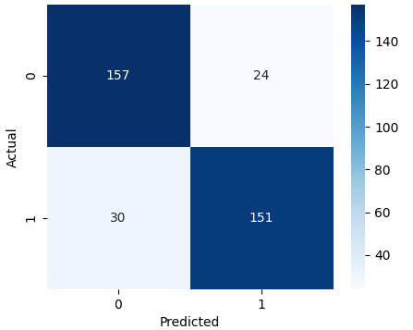
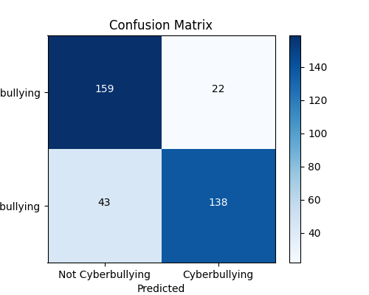
14.OUTPUTS
Logistic Regression | MuRIL Support Vector Machine | Naïve Bayes
MuRIL | XLM-RoBERTa | mDeBERTa

Slide 32
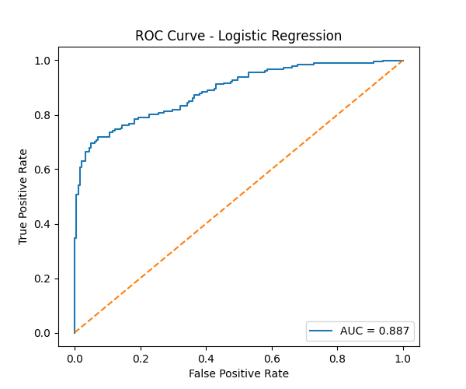
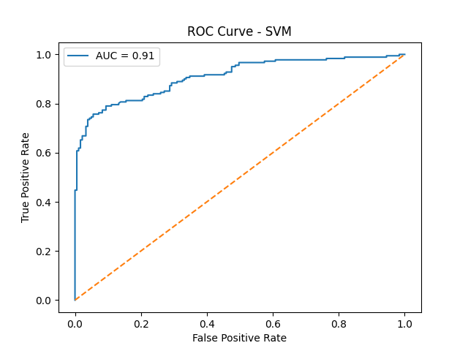
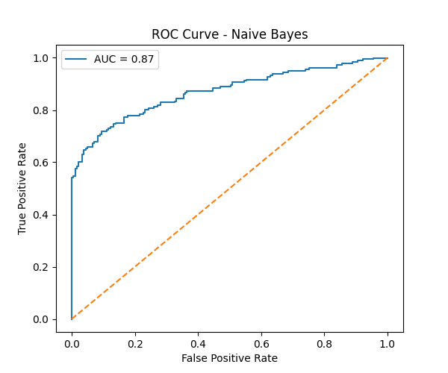
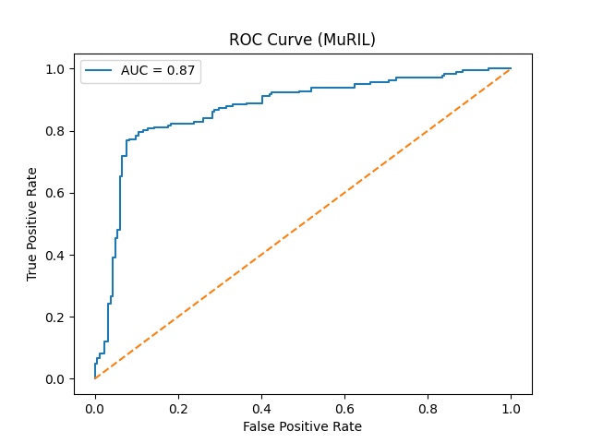
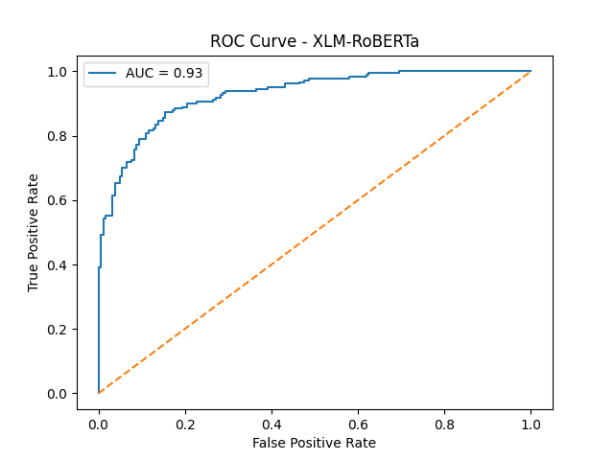
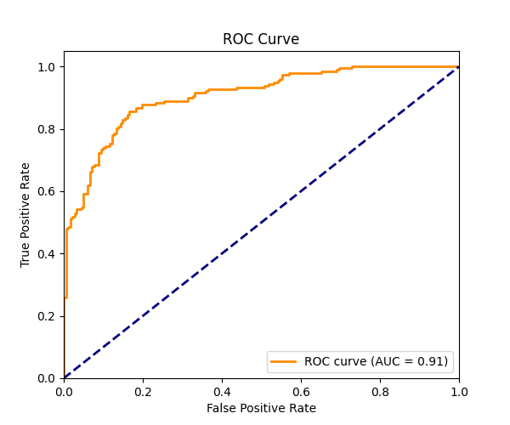
Logistic Regression | Support Vector Machine | Naïve Bayes
MuRIL | XLM-RoBERTa | mDeBERTa

Slide 33
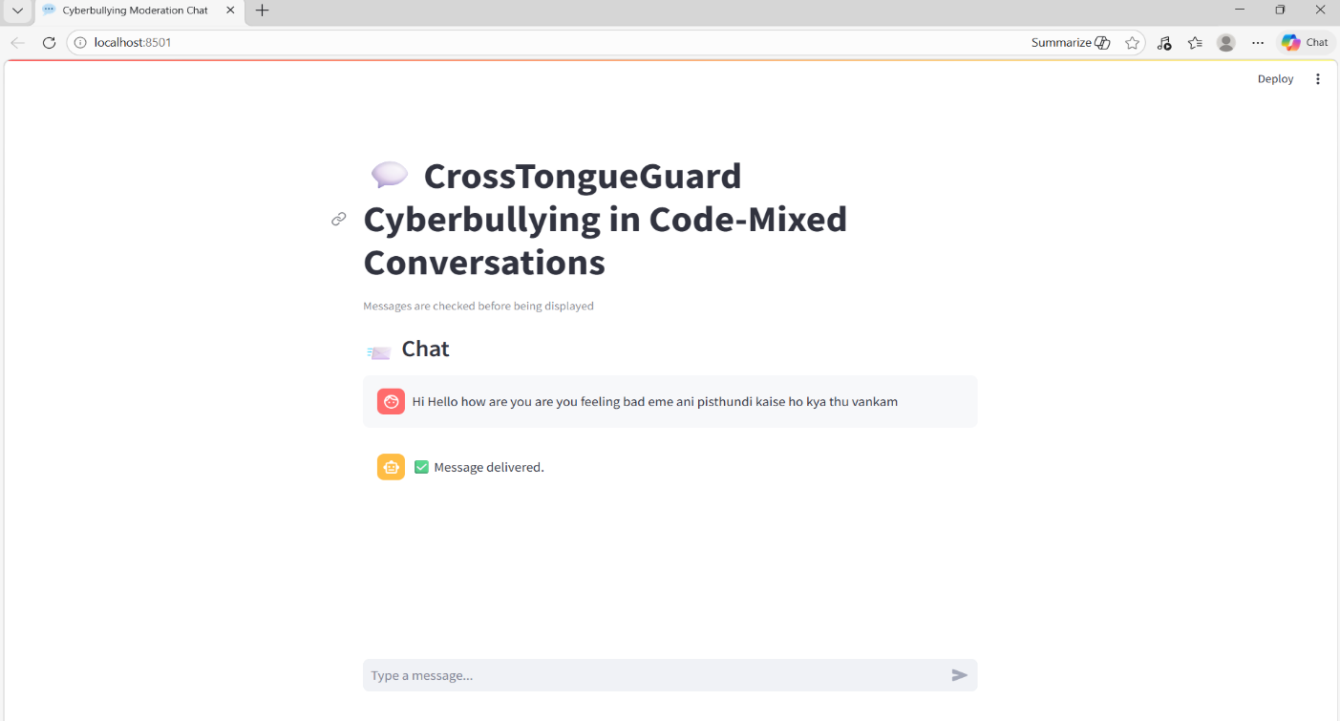
Figure 14.1-Non-Cyberbullying Output

Slide 34
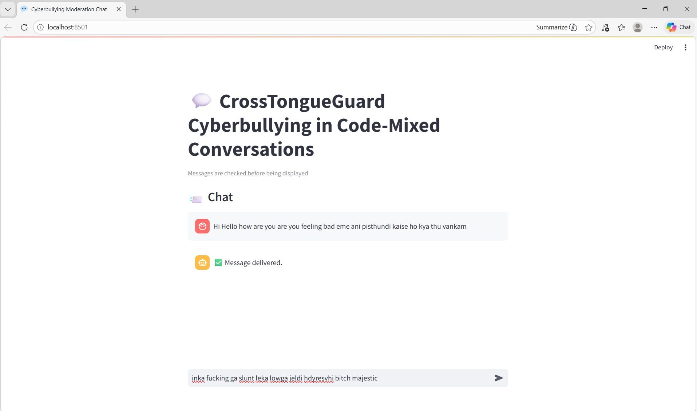
Figure 14.2-Enter any text

Slide 35
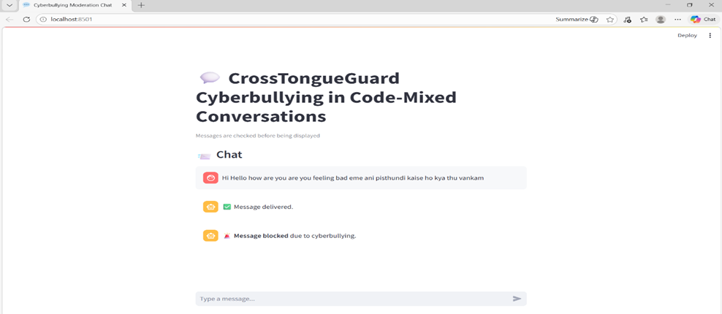
Figure 14.3-Cyberbullying Output

Slide 36
15. RESULTS AND DISCUSSION
The performance of the proposed cyberbullying detection system was evaluated using multiple machine learning and transformer-based models.
Each model was trained and tested on the same dataset and evaluated using standard metrics such as accuracy, precision, recall, and F1-score.
Among all the models, XLM-RoBERTa achieved the highest performance, with an accuracy of 85%, precision of 0.86, recall of 0.83, and F1-score of 0.84, making it the most effective model for detecting cyberbullying in code-mixed text.
The Support Vector Machine (SVM) also performed well among traditional models, achieving an accuracy of 83% and F1-score of 0.82.
The MuRIL model showed competitive performance with an accuracy of 83% and F1-score of 0.83, demonstrating its effectiveness in handling multilingual data.
The mDeBERTa model achieved an accuracy of 82% with balanced precision but slightly lower recall.
Logistic Regression provided moderate performance with an accuracy of 80%, while Naïve Bayes showed lower overall performance, with an accuracy of 63%, but a relatively higher recall, indicating its ability to detect more cyberbullying cases at the cost of increased false positives.

Slide 37
Table 1-Performance Comparison table of different models
Models | Accuracy | Precision | Recall | F1-Score
Logistic Regression | 0.80 | 0.83 | 0.75 | 0.79
Support Vector Machine | 0.83 | 0.86 | 0.79 | 0.82
Naïve Bayes | 0.63 | 0.58 | 0.74 | 0.72
MuRIL | 0.83 | 0.85 | 0.80 | 0.83
XLM-RoBERTa | 0.85 | 0.86 | 0.83 | 0.84
mDeBERTa | 0.82 | 0.86 | 0.76 | 0.80

Slide 38
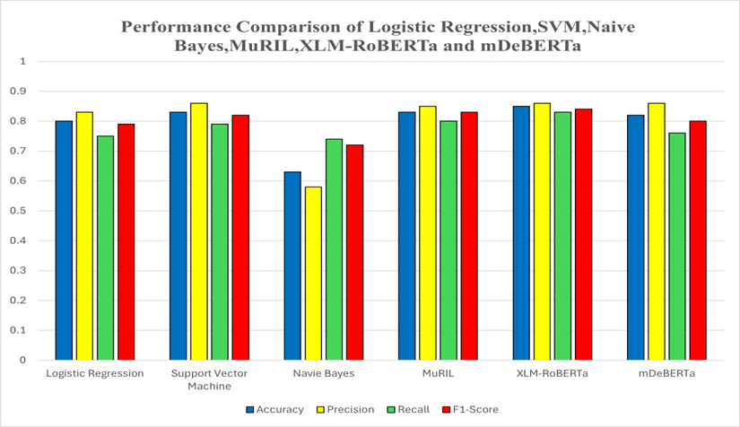
Figure 15.1-Performance Comparison Graph

Slide 39
16. CONCLUSION
This project presents a comprehensive comparative analysis of traditional machine learning classifier models and transformer-based models for cyberbullying detection.
The traditional classifier models considered in this work are Logistic Regression, SVM, and Naïve Bayes. On the other hand, multilingual transformer-based models, such as MuRIL, XLM-RoBERTa, and mDeBERTa, are considered.
The performance of each classifier was tested using accuracy, precision, recall, and F1-measure, confusion matrix, and ROC-AUC curve.
The experimental results show that transformer-based models perform significantly better than traditional classifier models in identifying the contextual and semantic nuances present in cyberbullying content.
Among all the models considered in this work, XLM-RoBERTa was found to perform the best. It had the highest accuracy, F1-measure, and Area Under the Curve (AUC). Its low number of false negatives also makes it more reliable in identifying harmful content.
Although SVM performed relatively well, Naïve Bayes performed well in terms of high recall value, its high number of false positives makes it less applicable. The results show that contextual embedding models perform significantly better than traditional frequency-based embedding models like TF-IDF.

Slide 40
17. REFERENCES
Maity, K., Jain, R., Jha, P., & Saha, S. (2024). Explainable cyberbullying detection in Hinglish: A generative approach. IEEE Transactions on Computational Social Systems, 11(3), 3338–3347.
Khanuja, S., Bansal, D., Mehtani, S., Khosla, S., Dey, A., Gopalan, B., &Talukdar, P. (2021). MuRIL: Multilingual representations for Indian languages. arXiv preprint arXiv:2103.10730.
He, P., Liu, X., Gao, J., & Chen, W. (2021). DeBERTa: Decoding enhanced BERT with disentangled attention. In Proceedings of the International Conference on Learning Representations (ICLR).
Conneau, A., Khandelwal, K., Goyal, N., Chaudhary, V., Wenzek, G., Guzm´ an, F., & Stoyanov, V. (2020). Unsupervised cross-lingual representation learning at scale. In Proceedings of the 58th Annual Meeting of the Association for Computational Linguistics (pp. 8440–8451).
Liu, Y., Ott, M., Goyal, N., Du, J., Joshi, M., Chen, D., & Stoyanov, V. (2019). RoBERTa: A robustly optimized BERT pretraining approach. arXiv preprint arXiv:1907.11692.
Devlin, J., Chang, M. W., Lee, K., & Toutanova, K. (2019). BERT: Pre training of deep bidirectional transformers for language understanding. In Proceedings of NAACL-HLT (pp. 4171–4186).
Davidson, T., Warmsley, D., Macy, M., & Weber, I. (2017). Automated hate speech detection and the problem of offensive language. In Proceedings of the International AAAI Conference on Web and Social Me dia (Vol. 11, pp. 512–515).

Slide 41
Malmasi, S., & Zampieri, M. (2017). Detecting hate speech in social media. arXiv preprint arXiv:1712.06427.
Badjatiya, P., Gupta, S., Gupta, M., & Varma, V. (2017). Deep learning for hate speech detection in tweets. In Proceedings of the 26th International Conference on World Wide Web Companion (pp. 759–760).
Salawu, S., He, Y., & Lumsden, J. (2017). Approaches to automated detection of cyberbullying: A survey. IEEE Transactions on Affective Computing, 11(1), 3–24.
Talat, Z., & Hovy, D. (2016). Hateful symbols or hateful people? Predictive features for hate speech detection on Twitter. In Proceedings of the NAACL Student Research Workshop (pp. 88–93).
Kowalski, R. M., Giumetti, G. W., Schroeder, A. N., & Lattanner, M. R. (2014). Bullying in the digital age: A critical review and meta analysis of cyberbullying research among youth. Psychological Bul letin, 140(4), 1073–1137.
Barman, U., Das, A., Wagner, J., & Foster, J. (2014). Code mixing: A challenge for language identification in social media. In Proceedings of the First Workshop on Computational Approaches to Code Switching (pp. 13–23).
Walker, C. M. (2014). Cyberbullying redefined: An analysis of intent and repetition. International Journal of Education and Social Science, 1(5), 59–69.
Chen, Y., Zhou, Y., Zhu, S., & Xu, H. (2012). Detecting offensive language in social media to protect adolescent online safety. In 2012 International Conference on Privacy, Security, Risk and Trust and So cial Computing (pp. 71–80). IEEE.
Patchin, J. W., & Hinduja, S. (2010). Cyberbullying and self-esteem. Journal of School Health, 80(12), 614–621.

Slide 42
https://www.kaggle.com/datasets/saurabhshahane/cyberbullying-dataset?select=youtube_parsed_dataset.csv
BOOKS
Speech and Language Processing – Daniel Jurafsky and James H. Martin
Natural Language Processing with Python – Steven Bird, Ewan Klein, Edward Loper
WEBSITES
Kaggle Dataset Platform-Used for Cyberbullying Datasets
Scikit-Learn Documentation-Machine Learning Models
HuggingFace Transformers-Transformers Models
NLTK Documentation-Text Preprocessing Tools
API’S
PyTorch –Deep Learning Framework

